Slide 1
DEVICE DEVELOPMENT

Slide 2
Objectives
Material Required
Team Composition
Task Division
Design Discussion
Project Phases

Slide 3
Material Required (Components)
For this stage we need to evolve a lot time but as basic research from the biostrap devices I got the results of some sensors and components
NRF52832
Max86140 optical sensor(spo2,smo2,rate)
Max20303 pmic(power manage)
5X310(proximity sensor)
Max17048(fuel gauge with model gauge)

Slide 4
NRf52832
NRF52832
- support BlE 5.2
- High speed 2/1mbps
- Operating --1.7v to 3.6 v
- Automatic power management system
- 32bit aem cortex-m4F processor
-
512/256 kb flash,64/32 kb Ram
2.4 GHz transceiver
Bulutooth low energy(BlE 5.1)
Nfc
Use for long distance communaction

Slide 5
Max86140 optical sensor(spo2,smo2,rate)
Integrated pulse oximeter and heart rate sensor
Analog device
Ambient light cancellation (alc)
Low power consumption(<10 uA(readout channel))
Built-in algo
Miniature(2.048*1.88mm)

Slide 6
Max20303 pmic(power manage)
Charging management ic
Wide fast charge range(5mA to 500mA)

Slide 7
5X310(proximity sensor)
Proximity sensor

Slide 8
Max17048(fuel gauge with model gauge)
Fuel gauge
17048-1 cell
17049-2 cell
Range (0v-12v) cell to gnd
Operating temp(-40’c – 85’c)

Slide 9
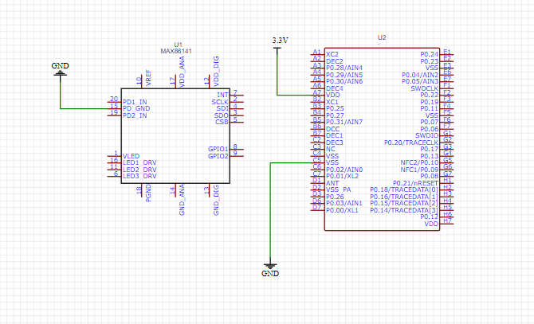
Interfacing of sensor with nrf852382

Slide 10
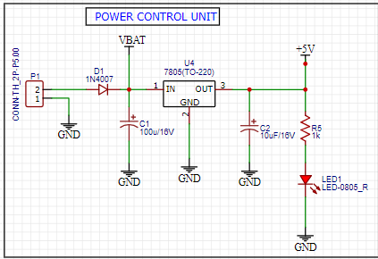
Power controlling unit

Slide 11
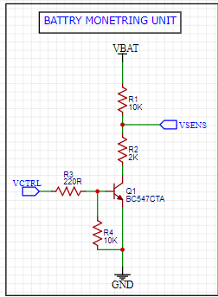
Battery monetring unit

Slide 12
TEAM COMPOSITION
Jyotiraditya – Mtech 1st year ECE, UIET KUK (Team Lead, ML & AI)
Himanshu – Btech 4th year ECE, UIET KUK (Database management)
Adarsh – Btech 3rd year ECE, UIET KUK (IOT & Device Development)
Vanshika – Btech 3rd year CSE, UIET KUK (App Developer)
Simran – Btech 4th year ECE, UIET KUK (Content creator)
Kunjal – Btech 2nd year ECE, UIET KUK (Graphics Designer)
Ojas – UIET Alumni (Cloud Computing, IOT & Device Development)

